Slide 1
Android Step Counter App
Submitted by:Raghav Rastogi
CSE-D
RA1811003030184

Slide 2
Abstract
These days everyone is very keen and very particular when it comes to health and health is directly proportional to our diet and exercise. So I am presenting to you a system which takes care of your health by monitoring three different parameters of your actions step counter, sleep intake and water intake. While registering into the system, you need to enter your age, height, weight and gender to determine BMI and calculate the sleep and water intake per day and the Step Counter uses the accelerometer sensor to get the input for counting the steps. While in water and sleep the system generates the amount of sleep and water the user to have, also the user can edit his physical attributes to as an when they are changed.

Slide 3

Software Used:
Android Studio(ver 3.1)
Languages:
Java-8
XML(Extensible Markup Language)
Database:SQLite

Slide 4
Hardware Requirements
Processor-i3 or above
Hard-Disk-5Gb
Memory-1Gb
Android Phone with Kitkat or Higher

Slide 5
Design Overview:
The application has 3 Activities/Modules.They are:
Login
Registration
Counter
The third screen/activity is divided into three tabs or fragments namely:
1)Steps
2)Water
3)Sleep

Slide 6
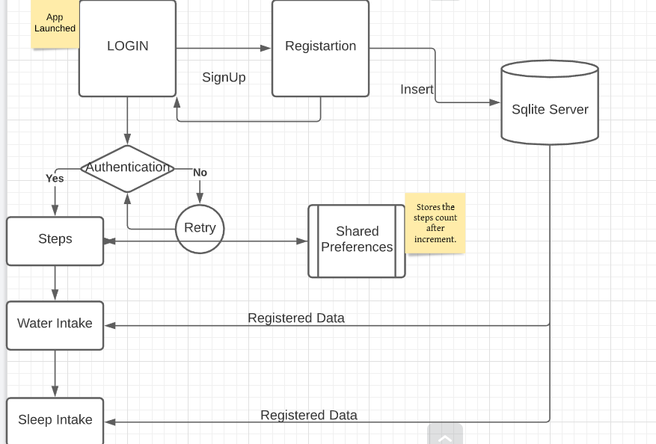

Slide 7
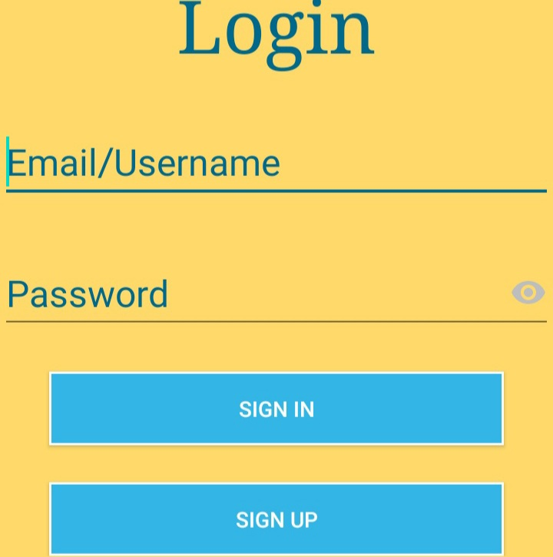
Login Screen(Main Activity)
For first time user,press the signup button to go to Registration Page.Otherwise enter email and password and press sign In.
Authentication is done using
Cursor and select query:
Select mail,pass from form where mail=‘”+username+”’ and pass=‘”+password+”’

Slide 8
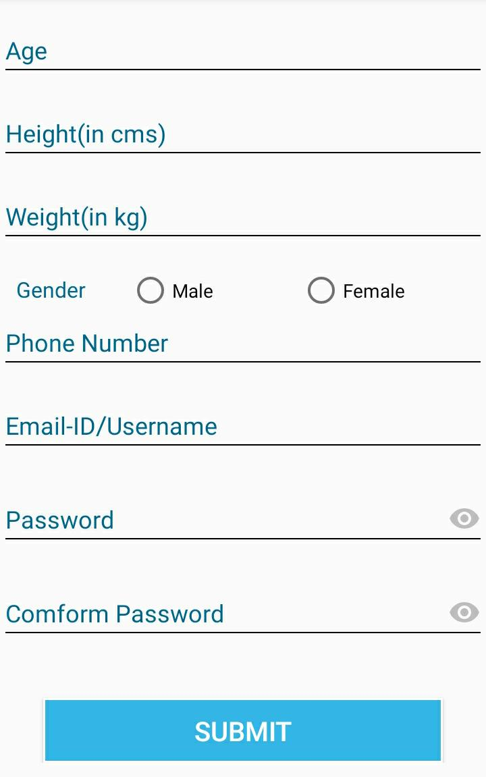
Registration:
After entering the essential details,and password confirmation,for m is submitted and data is inserted in the form table.
All fields are mandatory.
Submit Query:Insert into form values(age,height,weight,gen,pno,mail,pass)

Slide 9
SQLite Table Schema:
form:
Field | Type
Id(Primary Key) | Varchar(36)
Age | varchar(20)
Height | varchar(20)
Weight | varchar(20)
Gender | varchar(20)
Phone Number | varchar(20)
Mail | varchar(20)
Password | varchar(20)

Slide 10
Steps Fragment:
Real time step counting using TYPE_ACCELEROMETER(Harware based motion Sensor).
Motion sensors are useful for monitoring device movement, such as tilt, shake, rotation, or swing
The count is reset back to zero at the end of the day and can also be reset manually.

Slide 11
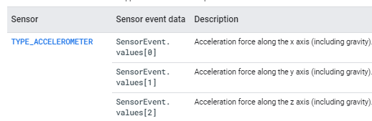
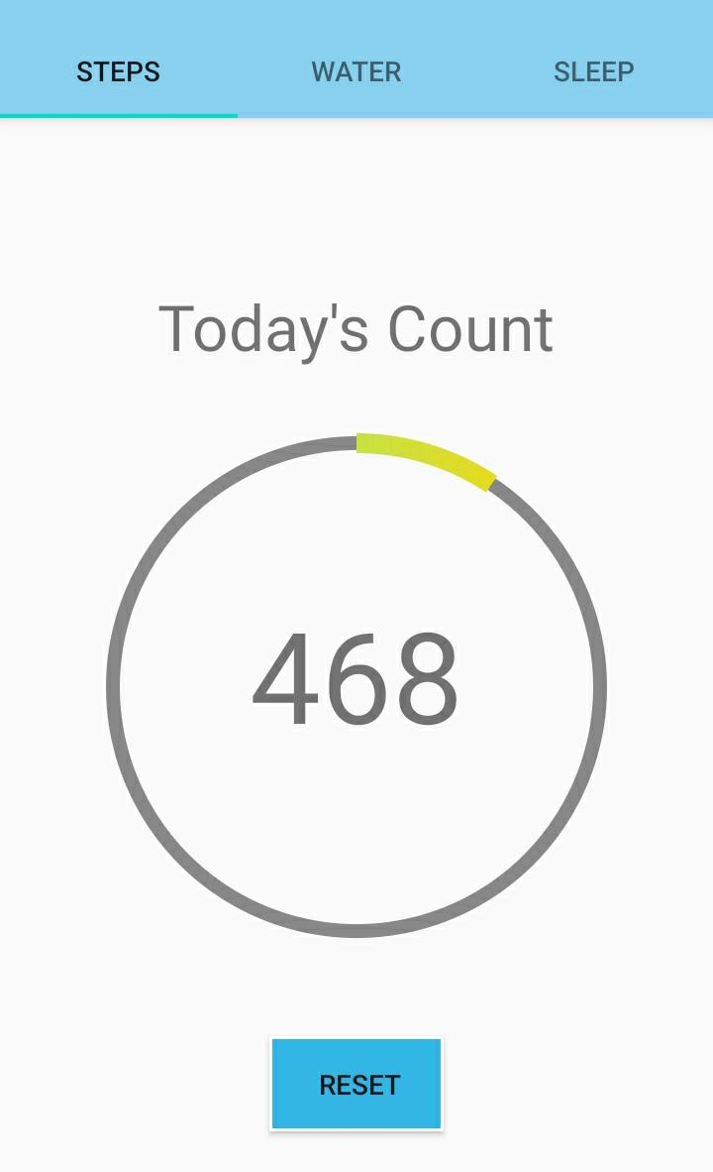
Step Fragment:
The linear acceleration sensor provides you with a three-dimensional vector representing acceleration along each device axis, including gravity.
The Circular progress bar keeps increasing as steps increase.
The sensor is calibrated.

Slide 12
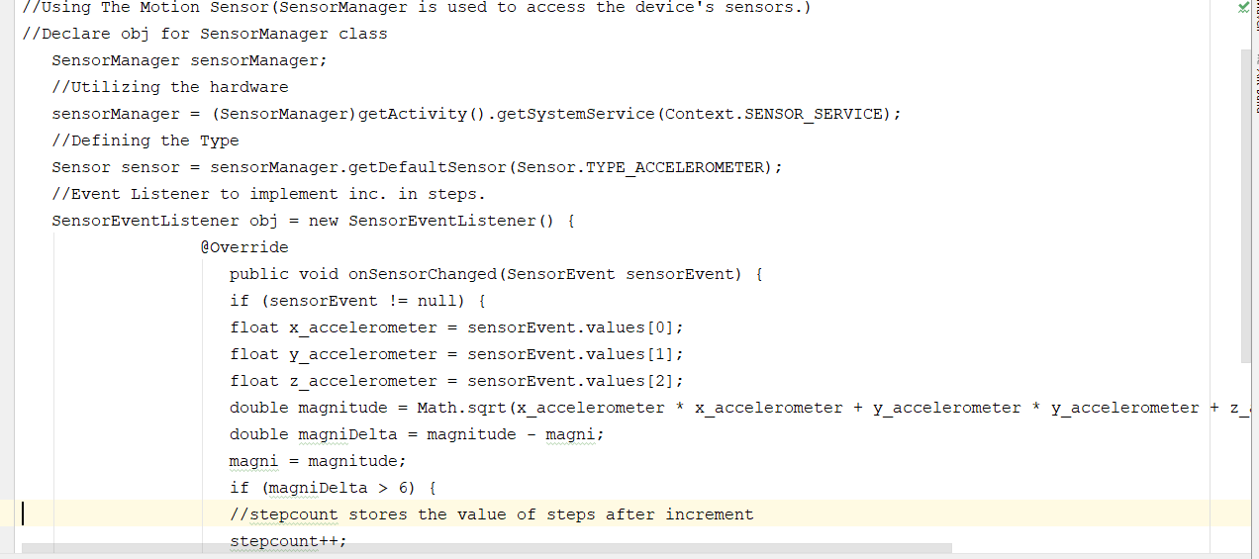

Code Implementation And Snippets:

Slide 13
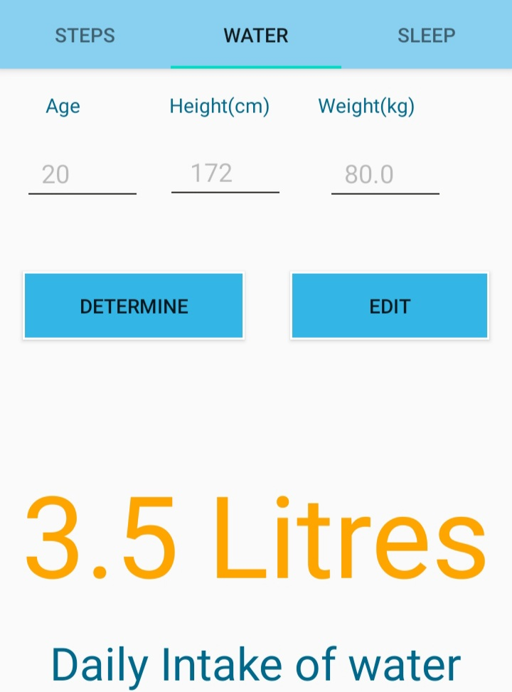
Water Intake:
Daily Water Intake the User is determined using BMI(Body Mass Index Values) and Hydration Calculator.
BMI=weight(kg)/(height(m)*height(m))

Slide 14
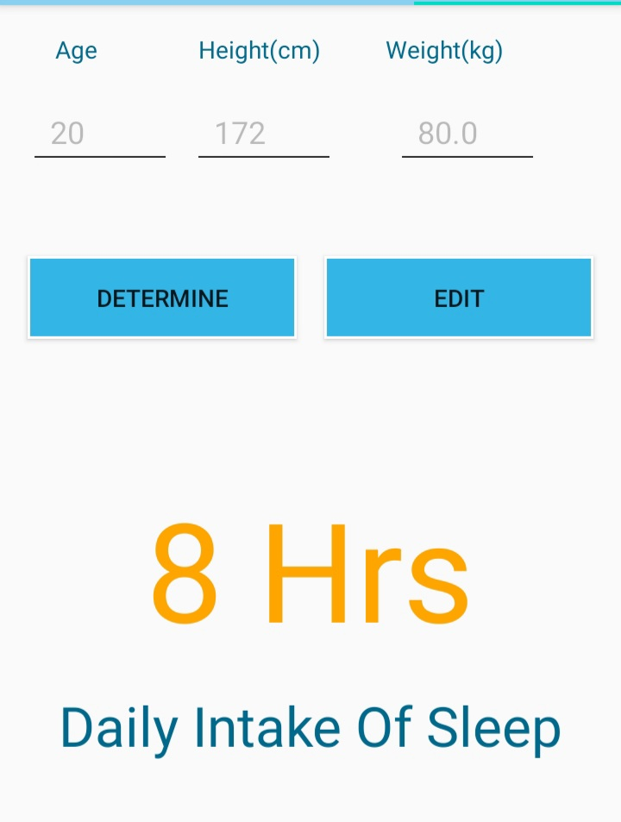
Sleep Intake:
Determines daily Sleep required by user using height and weight data fetched from SQLite.

Slide 15
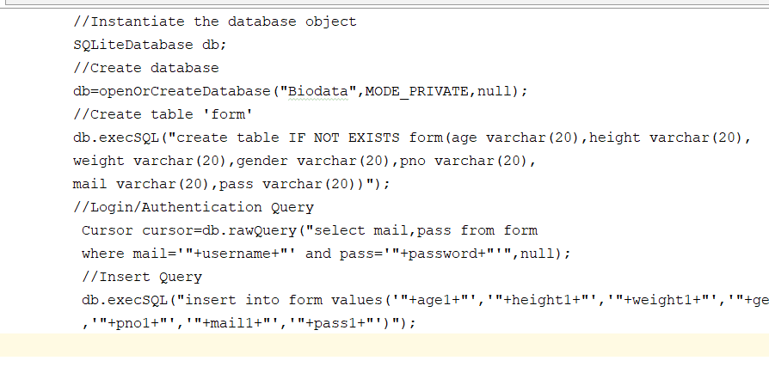
Code Implementation And Snippets:

Slide 16
Accuracy of the Tracker:
Observations:
Actual steps walked | Count on App
15 | 14
23 | 21
48 | 49
68 | 56
152 | 146
Total actual steps walked=306
Mean of actual steps observation=306/5=61.2
Total count on App=286
Mean of count=57.2
So the accuracy is:57.2/61.2 *100=93.46%
(*Accuracy may vary from device to device)

Slide 17
Permissions Required
The app requires the following permissions to work smoothly:
Body Sensors
Read Internal Storage
Write Internal Storage

Slide 18
Pros of the System
Real-Time step counting
Helps you track your steps in any phone with accelerometer sensor which almost any basic smart phone has.
Doesn’t require for the app to be Active.

Slide 19
Cons:
Step count may not be 100% accurate as the sensor used is accelerometer and not pedometer.

Slide 20
Conclusion
The project has been completed successfully with maximum satisfaction. The constraints are met and overcome successfully.The system is designed like it was decided in the design phase.The project gives a good idea on developing a user friendly app and the system is very flexible,robust and enables the user to use it without any inconveinience.The project is more informative and helpful for understanding concepts of android,sensors and databases.

Slide 21
References:
https://developer.android.com/
https://nevonprojects.com/
https://www.sqlitetutorial.net/
https://www.javatpoint.com

